Slide 1


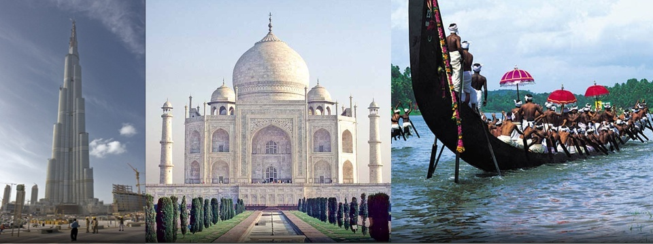
News On The Go!
How NewsHunt reached 1 Crore Downloads ?
INDIAN LANGUAGES!!

Slide 2
Landscape: Print Media: Local Languages Dominate!
India’s English Literacy is 8-10%
Vernacular Language Literacy is 65%
Readers (Millions)
Available on NewsHunt
Need for Local Language and Local Content is much bigger than English and Generic Content.`

Slide 3
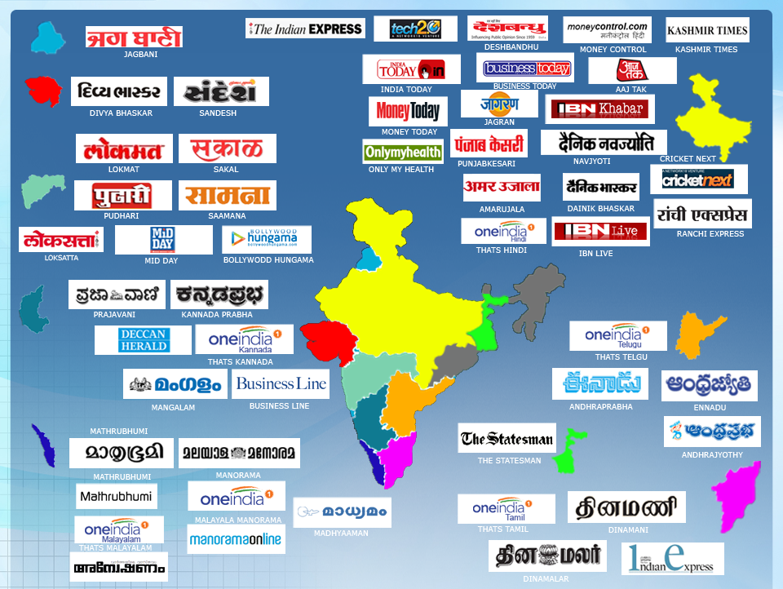

NewsHunt Coverage across India

Slide 4
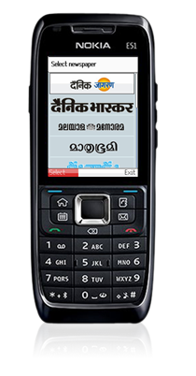
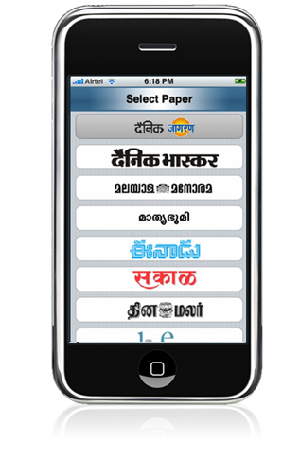
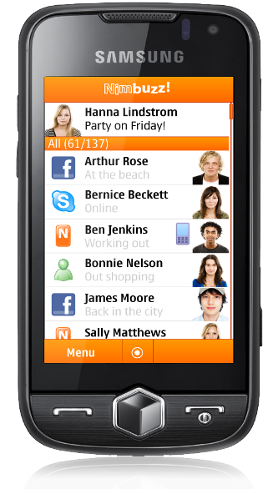
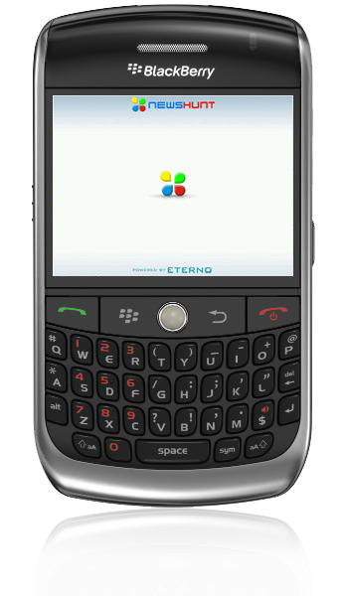
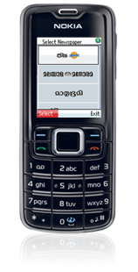
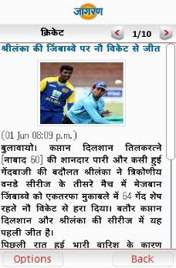
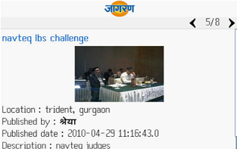

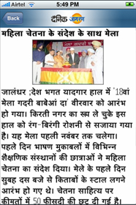
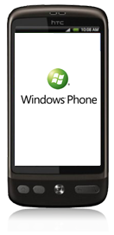
NewsHunt : Handsets and Platforms
From $40 Phone to Smart Phone, to Mobile Computers
Java
NOKIA S40, Samsung,
SonyEricsson, LG, etc…
Symbian
NOKIA S60, Others…
Blackberry
iPhone
Android
Launching Shortly

Slide 5
Usage of News & Video Mobile Apps: Total Minutes

Slide 6
Unicode Character Encoding
U+000000 :: U+10FFFF requires 21 bits (marked x below)
Unicode UTF-32
00000000 - 0010FFFF 00000000-000xxxxx-xxxxxxxx-xxxxxxxx
ए = 00-00-09-0F
Unicode UTF-16
00000000 - 0000FFFF xxxxxxxx-xxxxxxxx
00010000 - 0010FFFF 110110yy-yyxxxxxx 110111xx-xxxxxxxx
ए = 09-0F
Unicode UTF-8
00000000 - 0000007F 0xxxxxxxx
00000080 - 000007FF 110xxxxx 10xxxxxx
00000800 - 0000FFFF 1110xxxx 10xxxxxx 10xxxxxx
00010000 - 001FFFFF 11110xxx 10xxxxxx 10xxxxxx 10xxxxxx
00200000 - 03FFFFFF* 111110xx 10xxxxxx 10xxxxxx 10xxxxxx 10xxxxxx
04000000 - 7FFFFFFF* 1111110x 10xxxxxx 10xxxxxx 10xxxxxx 10xxxxxx 10xxxxxx
ए = E0-A4-8F
UTF-16 090F = 0000-1001-0000-1111
UTF-8 = 11100000 10100100 10001111 = E0-A4-8F
UTF-16BE = 09 0F
UTF-16LE = 0F 09
UTF-16 is backward compatible to UCS-2
UTF-8 variable length, multi byte format.
UTF-8 is backward compatible with 7 bit ASCII

Slide 7
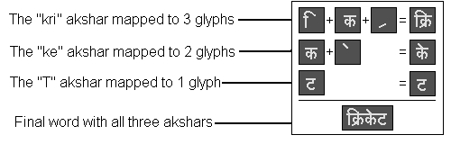
Text Rendering …
{U+0915, U+094D, U+0930, U+093F, U+0915, U+0947, U+091F}
{Letter K, Half Indicator, Letter R, I matra, Letter K, E matra, Letter T}
This needs to be composed to group of Akshars
{{0x915,0x94D,0x930,0x93F},{0x915,0x947},{0x91F}} which is
{{Unicodes forming kri},{unicodes forming ke},{unicodes forming T}}
Each Akshar needs to be mapped to visually ordered sequence of glyph indices within font
And then this glyph sequence is drawn

Slide 8

Chandu Sohoni
chandu.sohoni@eternoinfotech.com

